Slide 1

Contract Law
Trinity Law School, LA521
Prof. Sharon Kaselonis
skaselonis@tiu.edu

Slide 2
Contract Law Week 2
Week 1 Review
Remedies for a broken Contract

Slide 3

Biblical Application
We broke our “contract” with God through sin
“Therefore, just as sin came into the world through one man, and death through sin, and so death spread to all men because all sinned” Rom. 5:12
“for all have sinned and fall short of the glory of God” Rom. 3:23
God is Judge and a judgment of damages was placed on us
“For the wages of sin is death; but the free gift of God is eternal life in Christ Jesus our Lord.”
Rom. 6:23
Christ stepped in and paid our damages
“Jesus canceled the record of debt we owed by nailing it to the cross.” Col. 2:14
This Photo by Unknown Author is licensed under CC BY

Slide 4
Contract Law
Key Take Aways:
Contracts have played a role in the rise and fall of nations
The law of contracts aids in the governance of societies and the marketplace
Not ALL promises are legally enforceable
Sources of contract law (Common law, UCC, Restatement)
Which source of law to apply
3 Dimensions of Law (Doctrine, Facts, Theory: Public Policy)
Review of Week 1

Slide 5
Contract Law
Definitions and Terms:
Contract (Restatement 2d, § 1.)
Promisor & Promisee
Quid Pro Quo
Assumpsit
Warranty of Cure
“Merchant” UCC §2-104(1)
“Good faith” UCC §1-201(20)
Review of Week 1

Slide 6
Contract Law
1st Determination: Is there in fact a Contract
In making this determination of whether there was in fact a contract, a court will ask the following three basic questions:
Was there mutual assent?
Was there consideration or some substitute for consideration?
Are there any defenses to the creation of the contract?
Review of Week 1

Slide 7
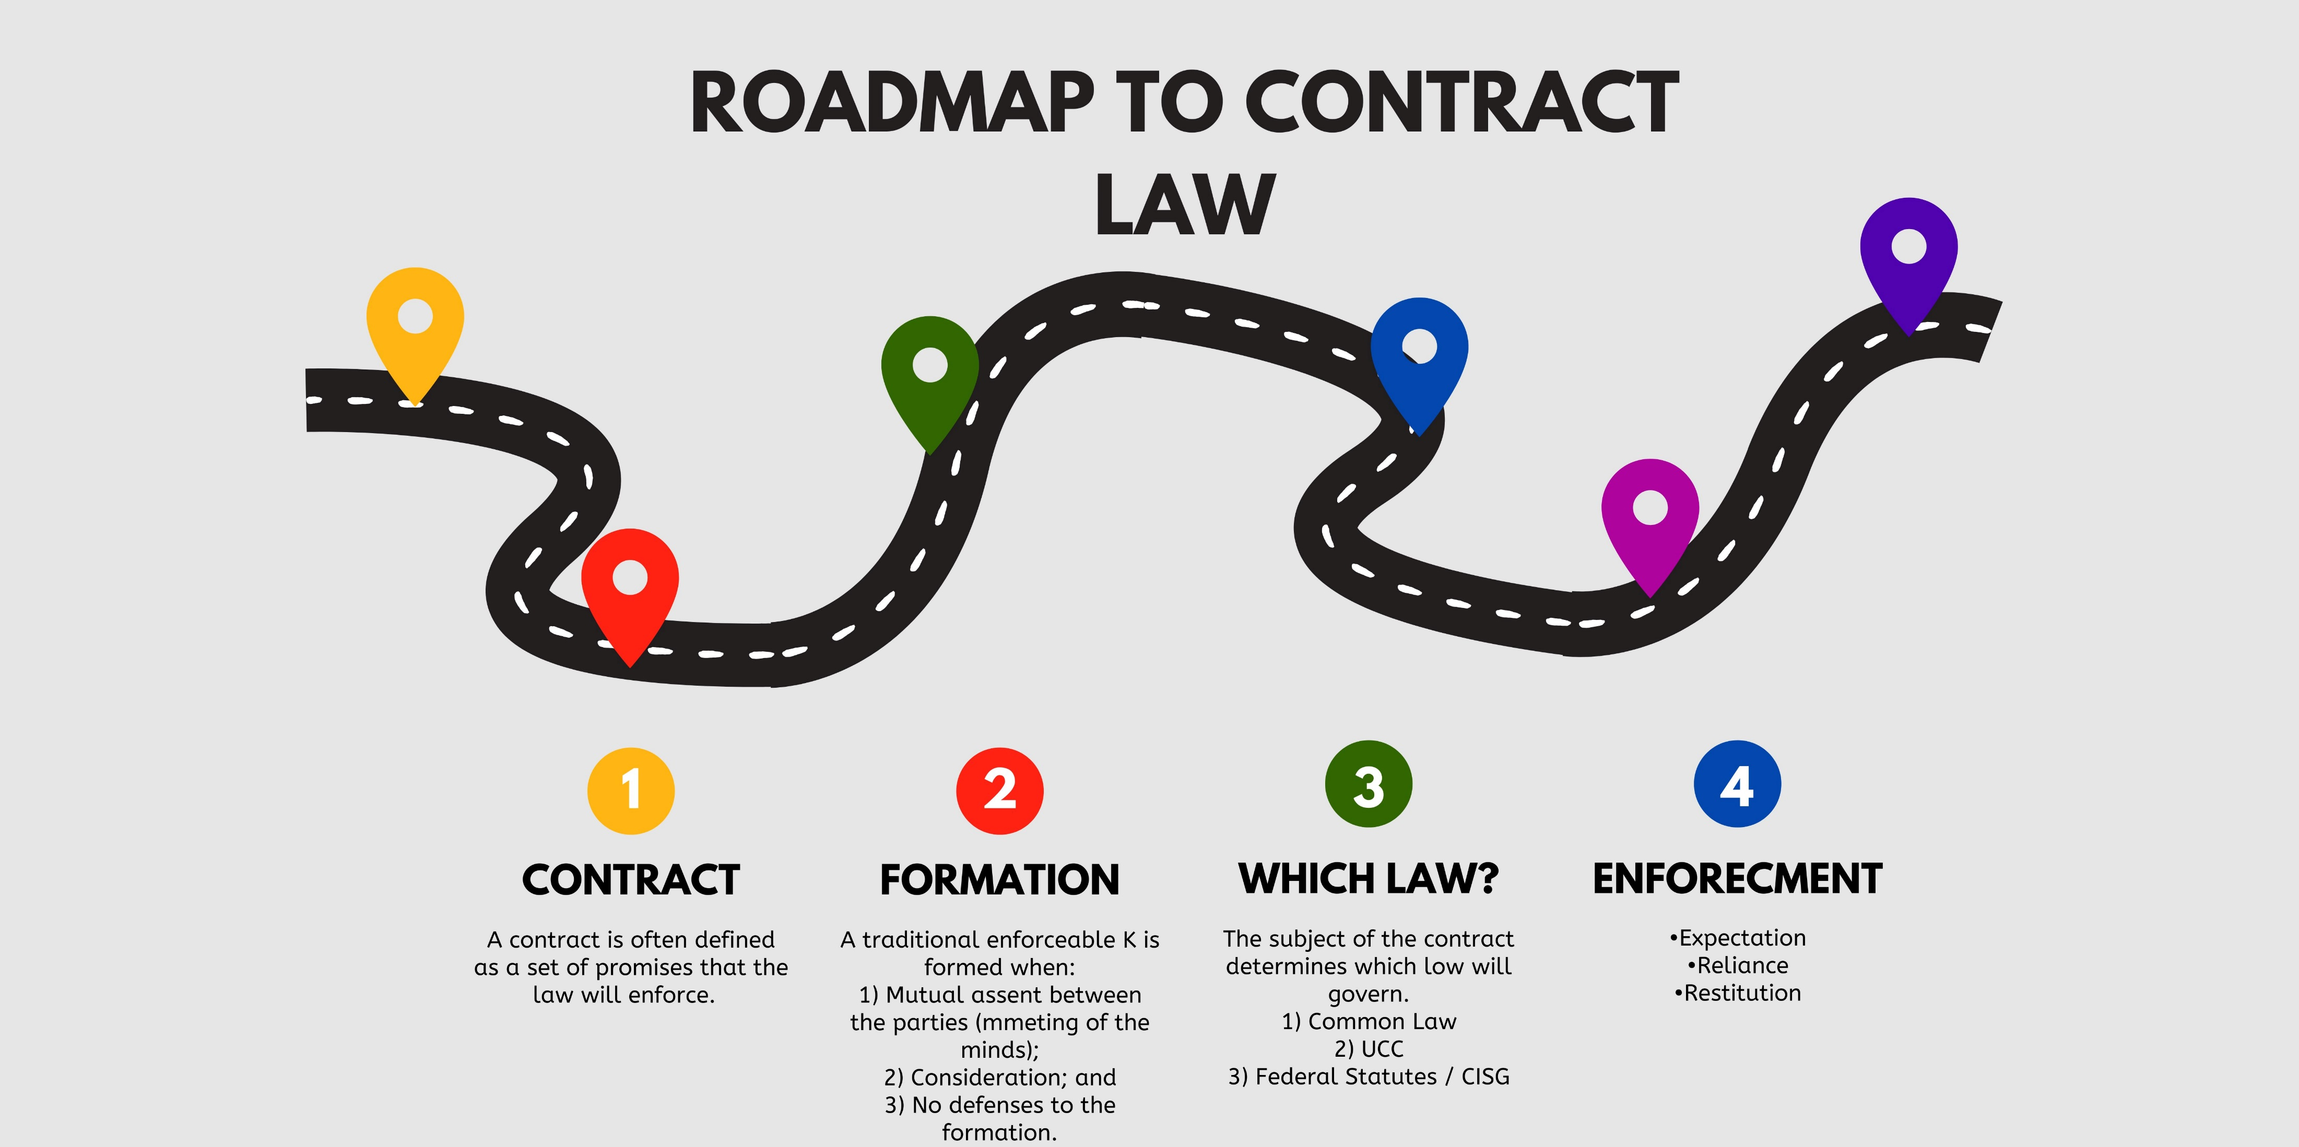

Slide 8
Beginning at the End
Why study Remedies 1st?
What type of remedies are available at law?
Monetary
Specific Performance

Slide 9

Types of Damages
See textbook, pg 34
Expectation damages
As if the K had been performed
Reliance damages
As if the K had never been made
Restitution damages
Give back the benefit given – restore the benefit/equity may take precedence over technicalities

Slide 10
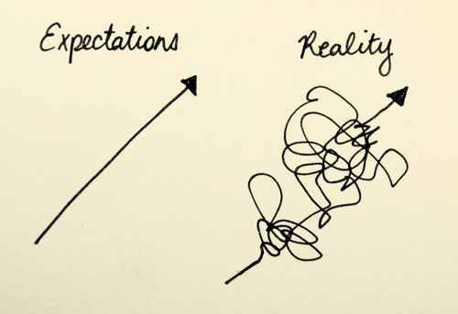
Expectation Damages
Image source:agmovementproject.com

Slide 11
Expectation Damages
In general, the amount of the award is measured by the promise’s expectation interest or, as it is sometimes said, “the benefit of the bargain.”
Purpose
The purpose of contract damages is to give compensation for the breach, i.e., to put the nonbreaching party in the position they would have been in had the promise been performed so far as money can do this.

Slide 12

Damages - Restatement
§347. MEASURE OF DAMAGES IN GENERAL
Subject to the limitations stated in §§350-353, the injured party has a right to damages based on his expectation interest as measured by
(a) the loss in the value to him of the other party’s performance caused by its failure or deficiency, plus
(b) any other loss, including incidental or consequential loss, caused by the breach, less
(c) any cost or other loss that he has avoided by not having to perform.

Slide 13

Expectation Damages
The goal is to put the non breaching party in the position they would have been if the K had been performed as promised.
Expectation damages = Cost and loss avoidance
(Loss in Value) +
(Other Losses) –
(Cost Avoided) –
(Loss Avoided) = damage

Slide 14
Expectation Damages Calculated
Expectation damages = Cost and loss avoidance
(Loss in Value) + (Other Losses) – (Cost Avoided) – (Loss Avoided)
Loss in Value = Value P should have received under the K – Value P did receive
Other Losses = Incidental Costs (i.e., storage / incurred reasonably to avoid other loss) + Consequential Costs (unique to this specific P, foreseeable or anticipated by other party, Hadley v. Baxendale)
Cost Avoided = Value P saves by NOT having to perform any further
Loss Avoided = Value P recovers by salvaging resources that would have been used to perform K
E.g., Revenue = $100k; Est. Expenses = $90k; Amount spent = $20k
($100k) + ($0) – ($70k) – ($0) = $30k
Double check your work = remember the goal and ask, did you make him whole

Slide 15

Expectation Damages What to do with speculation
If the plaintiff’s expectation damages are too speculative to measure
(e.g., the plaintiff cannot show with sufficient certainty the profits they would have made if the defendant had performed the contract),
the plaintiff may elect to recover those damages they have suffered based on their reasonable reliance on the contract.

Slide 16
If Expectation damages are too speculative… let’s look at Reliance Damages
Goal – to put the P in the position they would have been in
had the K NEVER been formed.

Slide 17
Reliance Damages Restatement
Restatement of Contracts, 2d. § 349
The injured party can choose to go for reliance damages instead of expectation damages,
but such damages will be mitigated by any losses the plaintiff would have sustained if the contract had been performed.

Slide 18

Reliance Damages
Not part of the K
Seeks to compensate expenditures made in reliance to the performance of the K
Difficult to prove
How to mitigate in the drafting process?

Slide 19
Restitution Damages
Goal – Give back the benefit given – restore the benefit/equity may take precedence over technicalities
Restitution is based on preventing unjust enrichment when one has conferred a benefit on another without gratuitous intent. Restitution can provide a remedy not only when a contract exists and has been breached, but also when a contract is unenforceable, and in some cases when no contractual relationship exists at all between the parties.

Slide 20
Restitution Damages, cont.
When a contract is unenforceable or no contract between the parties exists, an action to recover restitutionary damages often is referred to as an action for an implied in law contract, an action in quasi-contract, or an action for quantum meruit.
Generally, the measure of restitution is the value of the benefit conferred.

Slide 21
Reliance vs Restitution Damages
Reliance damages look backward and ask:
“What did the plaintiff lose by trusting the promise?”
Restitution damages look at the defendant and ask:
“What did the defendant gain from the plaintiff?”Both avoid the benefit-of-the-bargain question, but they do so for different reasons and from different vantage points.

Slide 22
How to brief a Case
See page 9-10
Parties
Procedural facts
Historical Facts
Form of Relief
Arguments of the Parties
Outcome of the case
Reasoning of the Court
Your Analysis

Slide 23

Hawkins v. McGee
Expectation damages

Slide 24
Hawkins v. McGee
Unlike Shaheen, the court here IS enforcing an express warranty of cure.
Why is it reasonable to conclude that such a warranty was made my Dr. MCGee?
Why did the court NOT allow pain and suffering to be considered in the amount of damages?

Slide 25
Hawkins v. McGee, cont.
Rule: Expectation Damages
An award of expectation damages (“benefit of the bargain” damages), is the difference between the value of what was promised under the contract and the value of what the promissee in fact received (which includes incidental damages if they stem from the breach of contract).

Slide 26
Holding
Holding: “We, therefore, conclude that the true measure of the P’s damage in the present case is the difference between the value to him of a perfect hand or a good hand, such as the jury found the D promised him and the value of his hand in its present condition, including any incidental consequences fairly within the contemplation of the parties when they made their contract.”
Key language: The extent of the P; ‘s suffering does not measure this difference in value. The pain necessary incident to the serious surgical operation was a part of the contribution which the P was willing to make to his joint undertraining with the D to produce a good hand. It was a legal detriment suffered by him which constituted a part of the consideration given him for the contract. It represented a part of the price which he was willing to pay for a good hand, but it furnished no test of the value of a good hand or the difference between the value of the hand which the D promised and the one which resulted from the operation.”

Slide 27
How to Use Hawkins v. McGee
Cite if: the benefit of the bargain is the appropriate measure of damages
it is not always the right measure of damages for breach of K
Cite if: Too much is awarded for the benefit of the bargain
Things that a person would have paid for or suffered even if the contract had been performed 100% correctly
The main takeaway – things that are and are not part of expectation damages calculation

Slide 28
Sullivan v. O’Connor
Determination of damages: How do you “nose”

Slide 29
Holding
Holding: The court upheld the decision, allowing Sullivan to recover for her reliance interest, which aimed to return her to her pre-contract position. This was due to the contract involving personal service affecting her appearance and well-being, and Dr. O'Connor's breach causing harm beyond just performance failure.
This case highlights how courts determine damages in breach of contract cases based on the contract's context while balancing the protection of contractual expectations and compensating for personal injuries. It also illustrates the distinction between breach of contract and negligence claims in medical malpractice cases.

Slide 30
Compare
Key Differences in the Courts’ Decisions
Issue | Hawkins v. McGee | Sullivan v. O’Connor
Primary damages theory | Expectation | Reliance
View of certainty | Expectation deemed measurable | Expectation too speculative
Risk of overcompensation | Accepted | Actively avoided
Treatment of pain & suffering | Excluded (if part of bargain) | Included (as reliance loss)
Judicial posture | Formal and rule-driven | Flexible and policy-sensitive
The cases illustrate that expectation damages are the default, but not absolute. When expectation damages become uncertain, speculative, or unfairly expansive, courts may pivot to reliance damages to achieve a just result.

Slide 31
J.O. Hooker & Sons, Inc. v, Roberts Cabinet Co.
Mixed subject contracts
Common law vs. UCC

Slide 32
RULE
RULE:
If a sale involves both goods and services (e.g., a contract to both buy and install cabinets), a court will determine which aspect is dominant and apply the law governing that aspect to the whole contract.
However, if the contract divides payment between goods and services, then Article 2 will apply to the sale portion and the common law will apply to the services portion.

